Slide 1
Spectroscopy

Slide 2
In chemistry spectroscopy plays an important role in determination of structure of molecule
Spectroscopy is the study of interaction of energy with matter
When energy is applied to matter, it can be absorbed, emitted, cause a chemical change, of be transmitted
In spectroscopy, energy is supplied in the form of electromagnetic radiation which has properties of both a wave and a particle according to quantum mechanics
Thus electromagnetic radiation can be described as a wave occurring simultaneously in electrical and magnetic field. It also can be described as if it consisted of particles of quanta or photons. They are not seen together in the same experiment

Slide 3
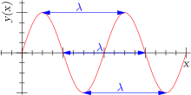
A wave is generally described by its wavelength (λ) or its frequency (ν) or wave number (ν)
λ: Distance between two consecutive crests (or troughs) Unit: m, mm, µm, nm
ν : number of full cycles of waves that passes through a given point each second as the wave moves through the space. Unit: Hz (cps), s⁻¹
ν : number of waves per cm. Unit: cm⁻¹
All electromagnetic radiation travels through vacuum at the same velocity (c) c = ν λ
The energy of electromagnetic radiation E = hν = h c/ λ

Slide 4
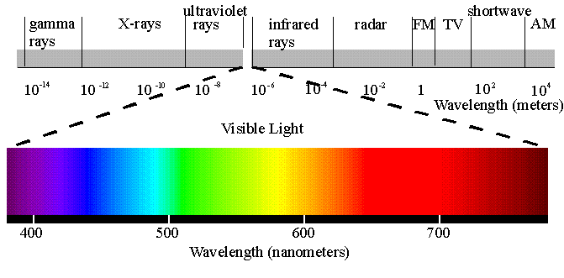
Electromagnetic Spectrum

Slide 5
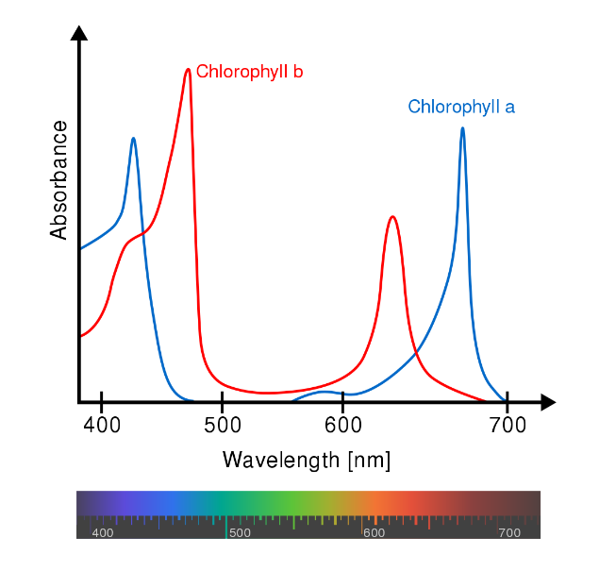
When an electromagnetic wave is allowed to pass through a matter, there will be gradual change in the intensity of electromagnetic radiation as the wavelength changes
Such change in the intensity with wavelength may be pictorially depicted by a graph having intensity vs wavelength
Such graph is known as spectrum
The instrument by which the variation of intensity and wavelength is measured is known as a spectrophotometer

Slide 6
Spectroscopy
Absorption
Atomic
Molecular
Emission

Slide 7
When an electromagnetic wave is allowed to pass through a molecule, energy is absorbed. After absorption of energy molecule is excited and is promoted to higher level. There are two such molecular excitation
Electronic excitation: This excitation requires generally 15-150 kcal/mole energy and this energy is available from the light of UV region. When absorption of energy from UV region is considered, the spectroscopy is called UV spectroscopy
Molecular vibration excitation: This excitation normally requires 1-15 kcal/ mole energy and is available from the light of IR region and such spectroscopy is known as IR spectroscopy

Slide 8
Uniqueness of Spectroscopy
The amount of light energy absorbed by the molecule, is the characteristic feature of the molecule under consideration
Hence from the amount of light absorbed, we may have an idea regarding the structural feature of the molecule concerned
Spectroscopic techniques are: UV,IR, NMR, ESP, Raman, Mass, Mössbauer

Slide 9
Absorption Spectroscopy
Absorption: electromagnetic (light) energy is transferred to atoms, ions, or molecules in the sample.
Results in a transition to a higher energy state.
Transition can be change in electronic levels, vibrations, rotations, translation, etc.
UV/Visible radiation cause electronic transition
Power (P): energy of a beam that reaches a given area per second
Intensity (I): power per unit solid angle
P and I related to amplitude
(excited state)
(ground state)

Slide 10
Lambert Beer’s Law: A = ε l c
The amount of light absorbed (A) by a sample is dependent on the path length (l), concentration of the sample (c) and a proportionality constant (ε – molar absorptivity)
Amount of light absorbed is dependent on frequency (λ)
Transmittance (T) = P/P_{o} %Transmittance = %T
Absorbance (A) = log₁₀ P_{o}/P
No light absorbed- % transmittance is 100% absorbance is 0
All light absorbed- % transmittance is 0% absorbance is infinite

Slide 11
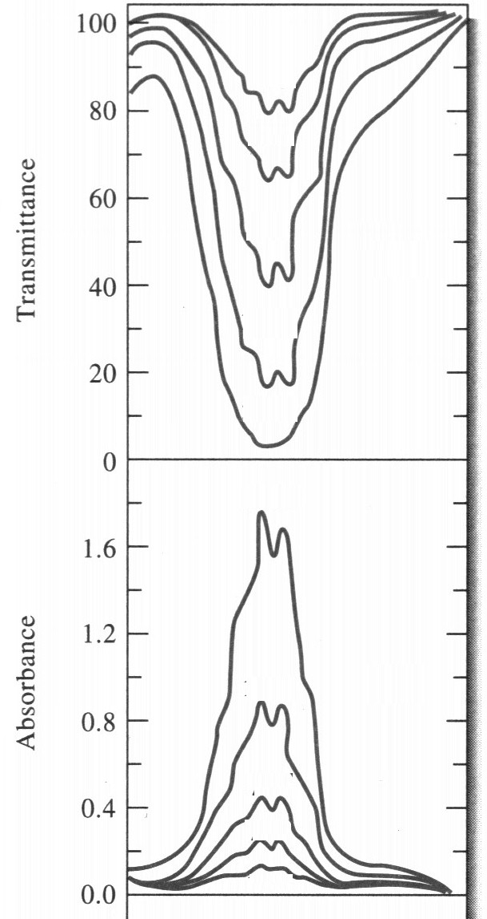
T, called the transmittance, Is a measure of the light that passes through the sample
T = P/Po
KMnO₄
A, the absorbance, is defined by
A = log₁₀(P_{o}/P)
= -log₁₀(T)
λ_{max}
wavelength at which A is a maximum

Slide 12
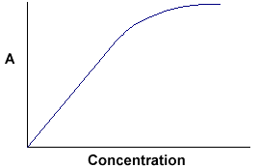
Relationship Described in Terms of Lambert-Beer’s Law A = Absorbance = εlc = -log (%T/100)
ε = molar absorptivity: constant for a compound at a given wave length (λ)
units of L mol⁻¹ cm⁻¹
l = path length: cell distance in cm
c = concentration: sample concentration in moles per liter.
Therefore, by measuring absorbance or percent transmittance at a given frequency we can get information related to the amount of sample (c) present with an identified ε and λ.
the proportionality constant, is called the extinction coefficient or molar absorptivity.
is the slope of the plot of A against c.
The magnitude of ε is wavelength dependent.

Slide 13
Deviations from the Beer-Lambert Law. Primarily due to the limitations of Beer’s Law A ∝ c
Effect of high concentrations :
High analyte concentrations > 0.01M, or the analyte in high electrolyte concentrations.
Arise from interactions between species in solution which become significant at high concentrations (ions get close together). Lead to curvature of the calibration line
i.e. ε, the molar absorptivity changes with concentration. Can no longer assume linearity c ≠ A/ε_{λ}
Chemical Effects:
ε_{λ} is species specific, and thus analytical conditions must be such that all the analyte should present as one species
eg. Cr₂O₇²⁻ + 2H₂O → 2CrO₄²⁻ + 2H₃O⁺
for Cr₂O₇²⁻ λ_{max} = 450nm while for CrO₄²⁻ λ_{max} = 368nm
A change in the pH changes the species distribution
Abs
Conc.

Slide 14
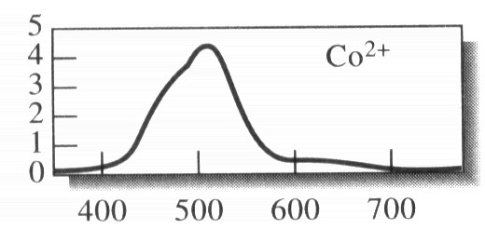
Instrumental Effects
Beer’s Law only strictly applies to monochromatic light (one λ only) but monochromators select a small range of wavelengths around the wavelength of choice.
Consider a situation where the wave-package from the monochromator ranged between λ₁ and λ₂:
The light passing through the sample will be the sum of all the wavelengths from λ₁ to λ₂.
λ₂
λ₁
Normally not a major problem provided the absorbance does not show large changes with wavelength

Slide 15
UV Spectroscopy
In UV spectroscopy, electronic transition takes place
For this, light from UV region is allowed to pass through the solution of the compound under investigation
The wavelength range of UV spectroscopy is 200 – 800 nm and the corresponding energy range is 15 – 150 kcal/ mole
After absorption of UV light electronic transitions occur.

Slide 16
In organic compounds there may be three types of electrons - σ, π and n. These electrons are promoted to the corresponding higher energy levels, i.e. to the antibonding orbitals. Since ‘n’ electrons have no antibonding orbitals of their own, they are promoted to the antibonding orbitals of σ and π electrons. Thus, a molecule having σ, π and n electrons may have four types of transitions:
σ to σ*
π to π*
n to σ*
n to π*

Slide 17
Out of these four transitions, σ - σ* transition requires very high energy which is generally not obtained from the light of UV region. So, in UV spectroscopy, normally σ - σ* transition does not occur. Therefore, in UV spectroscopic techniques, three types of transitions take place i.e., π - π*, n - σ* and n - π*
Further out of these 3 transitions, n - π* requires less amount of energy, i.e. occurs in light (visible) wavelength, while n - σ* needs maximum amount of energy (i.e. occurs at lower wavelength) and π - π* usually occurs in between.

Slide 18
Transition will occur only when maximum amount of energy that is required for transition is supplied. In other words, transition will occur at a particular wavelength denoted as λ_{max}. Thus from the determination of λ_{max} we can have an idea regarding the nature of electron, i.e. whether it is n, σ or π type.
The nature of the electrons means the functional nature, i.e., how the electron(s) behave in the molecule. Generally, functional nature of electron(s) is associated with the functional groups. Thus from UV spectroscopy we determine the nature of functional group.

Slide 19
It may be pointed out that, in this technique the functional groups are identified by the use of UV light. It has been observed that all the functional groups commonly encountered in organic molecule are not active towards UV light. So in this technique all the functional groups can not be identified, only certain functional groups which are active towards UV light may be identified. Such functional groups are known as chromophores. Thus chromophores may be defined as isolated multiple bonded functional groups which have characteristic UV light absorption property.
Compounds containing chromophoric groups are often called chromogens.

Slide 20
Characteristic features of chromophores
A particular chromophore present in different compound will absorb UV light at a particular range of wavelength.
Different chromophores will have different λ_{max}.
A particular chromophore present in different molecules may have same range of λ_{max} but intensity of UV light absorption may or may not be the same.

Slide 21
Intensity of UV light absorbed is measured from combined Lambert-Beer’s Law that may be mathematically expressed as log (I₀/I) = εcl. ε is the molar extinction coefficient.
From the value of ε we can have an idea regarding the intensity of the light absorbed. Greater the value of ε, higher the intensity of UV light absorption.
Again ε has been found to be related with the probability of transition as
ε = 0.87 x 10²⁰ x p x a
where p is the probability of transition, a is the target area i.e., size of the chromophore. Hence, greater the value of ε, higher is the probability of transition.

Slide 22
Thus from the value of ε we can get the following two information.
intensity of light absorption
Probability of transition. It may be pointed out that when the value of ε is above 10⁴ it is allowed transition & when its value is less than 10⁴ it is forbidden transition.
Some important chromophoric groups are: nitroso (-N=O), nitro, azo (-N=N-), azoxy (-N=N⁺- O⁻), azo amino (-N=N-NH), carbonyl (>C=O), thio carbonyl (>C=S), p-quinoid,o -quinoid

Slide 23
Auxochromes: the auxochromes are those functional groups which have no characteristic absorption property of their own but can change the λ_{max} of the chromophore when it is attached with that chromophore
Or
Saturated group with nonbonded electrons which, when attached to a chromophore, alters both the wavelength and the intensity of the absorption.
e.g. –OH, -NH₂ have no UV light absorption property
C₆H₆ (chromophore) λ_{max} = 250 nm Ph-OH λ_{max} = 275 nm Ph-NH₂ λ_{max} = 270 nm | Other examples: Acidic: -OH, -SO₃H, -COOH Basic: -NH₂, -NHR, -NR₂

Slide 24
Bathochromic shift (Red shift): When λ_{max} is shifted towards longer wavelength due to substitution or solvent effect. e.g. for PhH λ_{max} = 250 nm, for Ph-OH λ_{max} = 275 nm.
Hypsochromic shift (Blue shift): this shift is due to the change of λ_{max} towards shorter wavelength due to substitution or solvent effect. e.g. for PhNH₂ λ_{max} = 270 nm, for Ph-NH₃⁺ λ_{max} = 275 nm.
Hyperchromic shift: When there is change in ε towards higher value, i.e. an increase in absorption intensity the change is known as hyperchromic shift.
Hypochromic shift: If in any circumstance there is shifting of ε towards lower value, i.e. a decrease in absorption intensity the shift is termed as hypochromic shift.

Slide 25
From the relation ε = 0.87 x 10²⁰ x p x a, where a id the target area i.e., the size of the chromophore, it may be concluded that transition and intensity of UV light absorbed depends upon the size of the chromophore. Greater the size of the chromophore, more intense will be the absorption of UV light.
Size of the chromophore depends upon delocalisation. More the delocalisation, more intense will be the absorption. Again delocalisation is associated with conjugation. Greater the conjugation, greater will be the delocalisation and more intense will be the absorption of UV light.
-C=C-C-C=C-C- -C-C=C-C=C-C-
That is why conjugated chromophores absorb UV light more readily than isolated chromophores

Slide 26
Since UV energy is quantaised, the absorption spectrum arising from a single electronic transition should consist of a single, discrete line. But in UV spectroscopy, the peaks are not sharp but broad in character. This is due to the superimposition of electronic absorption on rotational and vibrational sublevels. Electronic transition (in UV) takes place in the energy range 15 – 150 kcal /mole.
Within this energy range vibrational transition, which requires only 1-15 Kcal/mole energy, also takes place.
For this reason the peaks in UV spectra
become broad instead of sharp.
That is why in UV spectroscopy
peaks are generally termed as bands.

Slide 27
Different types of bands in UV spectroscopy
K band: This band is due to the conjugation of chromophore (-C=C-C=C-). Thus when two chromophores are in conjugation, they will form a new chromophore by their mutual overlapping. The band due to such new conjugated chromophore is known as K band.
B band: This band is due to benzenoid ring and is normally observed in aromatic compounds, both homocyclic and heterocyclic. This band generally appears around 250 nm.
E band: This is ethylenic band and is generally observed in aromatic system. This band appears around 180-190 nm and around 205 nm.
R band: This is due tp the transition of n - π* i.e. band due to transition of non-bonded electrons to π* orbital.

Slide 28
Application of UV spectroscopy
to identify the chromophore (from λ_{max} )
transition probability (from e)
extent of conjugation
stereochemistry in some cases
distinction between isomeric compounds

Slide 29
Advantages of UV/Visible spectroscopy:
Clinical, inorganic, organic, biochemical analysis
Very high sensitivity : molar absorbtivities generally large (ε = 23,300)
Low detection limits: often μM (titrations ~ mM)
Reasonable selectivity : few interferences in most methods
Good precision : ± 5% of calculated concentrations
Convenient – rapidly performed, minimal costs
single beam, visible ~ Rs. 30000 double beam, UV/vis, Rs. 200000

Slide 30
Woodward Fisher empirical rule for calculation of λ_{max} for dienes

Slide 32
Infrared (IR)Spectroscopy
IR spectroscopy provides a simple and rapid instrumental technique that can give evidence for the preence of various functional groups.
IR spectroscopy- as all forms of spectroscopy depends on the interaction of molecules or atoms with electromagnetic radiation
IR radiation refers broadly to the part of the electromagnetic spectrum between visible and microwave region. Of greatest practical use is the limited portion between 4000 and 400cm⁻¹

Slide 33
Infrared radiation ( associated with 1-15 kcal/mole energy) causes atoms and groups of atoms of organic compounds to vibrated with increased amplitude about the covalent bonds that connect them
Since the functional groups of organic molecules include specific arrangement of bonded atoms, absorption of IR energy by an organic molecule will occur in a manner characteristic of the types of bonds and atoms present in the specific functional groups of that molecule.
These variations are quantized and they occur when the compound absorb IR energy in particular regions of the IR portion of the spectrum

Slide 34
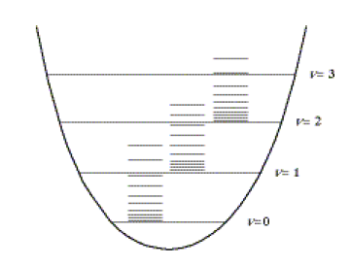
Based on IR absorption by molecules as undergo vibrational and rotational transitions
IR radiation is in the range of 12,800 – 10 cm⁻¹ or λ = 0.78 – 1000 mm
- rotational transitions have small energy differences
≤ 100 cm⁻¹, l > 100 mm
- vibrational transitions occur at higher energies
- rotational and vibrational transitions often occur together
rotational transitions
Potential Energy (E)
Vibrational transitions
Interatomic Distance (r)

Slide 35
Generally vibration frequency of a particular bond depends upon
Strength or relative stiffness of the bond. Triple bonds are stiffer (and vibrate at higher frequencies) than double bonds while double bonds are stiffer than single bonds
Masses of the bonded atoms – light atoms vibrate at higher frequencies than heavier atoms
Geometry of the molecule

Slide 36
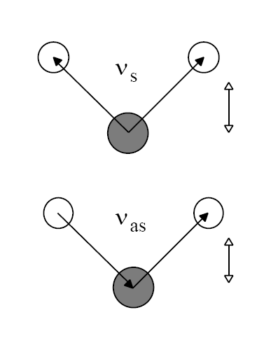
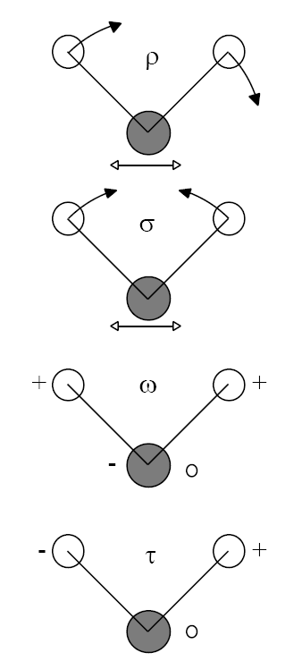
Types of Molecular Vibrations
Bond Stretching
Bond Bending
In-plane rocking
symmetric
In-plane scissoring
asymmetric
Out-of-plane wagging
Out-of-plane twisting

Slide 37
symmetric
asymmetric
In-plane scissoring
Out-of-plane twisting
In-plane rocking
Out-of-plane wagging

Slide 38
Essential Requirement
Not all the molecular vibrations result in the absorption of IR energy.
For a vibration to occur with the absorption of IR energy, the dipole moment of the molecule must change during vibration (but it is not necessary for the molecule to possess a permanent dipole moment)
Greater the dipole moment change, more intense will be the absorption of IR light and more smooth will be the vibrational transition.
Thus it may be concluded that absorption of IR light (i.e. vibrational change) depend upon the symmetry of the molecule.
Greater the symmetry, less will be the absorption of IR energy, consequently less will be the vibrational transition.

Slide 39
Symmetric molecules like H₂, O₂ etc. will have less vibrational change whereas CO will have greater vibrational transition.
Similarly, carbonyl group (>C=O) will have greater probability of vibrational transition than that of ethylenic molecule (>C=C<).
Again in case of cis isomer, vibrational transition will be more intense than the corresponding trans isomer.

Slide 40
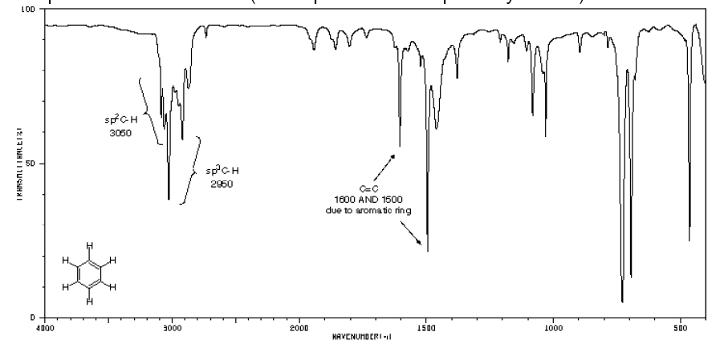
Typical IR spectrum for Organic Molecule

Slide 41
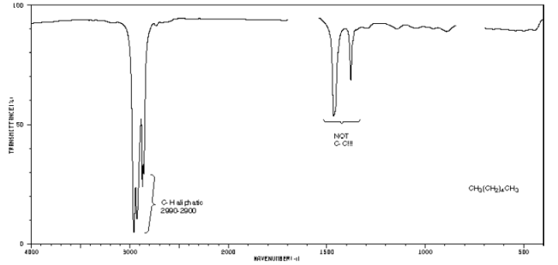
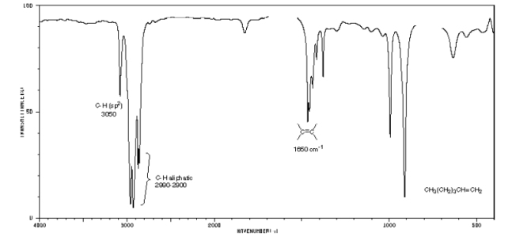
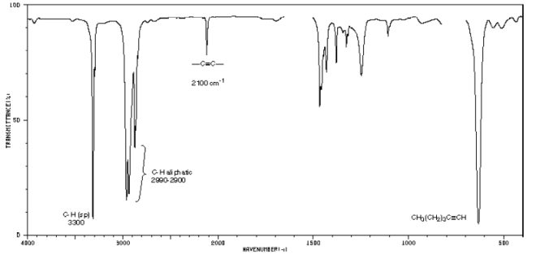
Typical IR spectrum for Organic Molecule
- many more bands than in UV-vis, fluorescence or phosphorescence
- bands are also much sharper
- pattern is distinct for given molecule
except for optical isomers
- good qualitative tool
can be used for compound identification
group analysis
also quantitative tool
intensity of bands related to amount of compound present
- spectra usually shown as percent transmittance (instead of absorbance) vs. wavenumber (instead of λ) for convenience
Hexane
Hexene
Hexyne

Slide 42
Hooke’s Law
Assignments for stretching frequencies can be approximated by the application of Hooke’s law
According to Hooke’s law, the frequency of vibration is directly proportional to the square root of the force constant of the bond and inversely proportional to the square root of the reduced mass of the system
Thus Vibrational frequency given by
where:
: vibrational frequency in cm⁻¹
k: force constant (measure of bond stiffness) in dyne cm⁻¹ or gm sec⁻²
μ: reduced mass – m₁m₂/m₁+m₂, m₁ mass of atom 1 in gm
If ν and atoms in bond are known, one can get k:
Single bonds: k ~ 3x10² to 8 x10² N/m (Avg ~ 5x10²);
double and triple bonds ~ 2x and 3x k for single bond
So, vibration ν occur in order: single < double < triple

Slide 43
1.for a stronger bond (larger k value), ν increases
As examples of this, in order of increasing bond strength compare: CC bonds: C-C (1000 cm⁻¹), C=C (1600 cm⁻¹) and C≡C (2200 cm⁻¹), CH bonds: C-C-H (2900 cm⁻¹), C=C-H (3100 cm⁻¹) and C≡C-H (3300 cm⁻¹ )
2. for heavier atoms attached (larger m value), ν decreases.
As examples of this, in order of increasing reduced mass compare
C-H (3000 cm⁻¹) C-C (1000 cm⁻¹) C-Cl (800 cm⁻¹) C-Br (550 cm⁻¹) C-I (about 500 cm⁻¹)
Question: Calculate the absorption frequency for the C-H stretch with a force constant of k = 5.0x10² N/m.

Slide 44
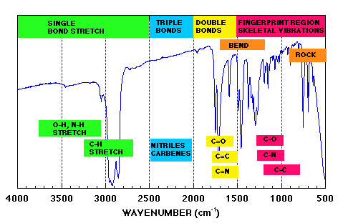
Application of IR
1.) Qualitative Analysis (Compound Identification)
- main application
- Use of IR, with NMR and MS, in late 1950’s revolutionized organic chemistry
► decreased the time to confirm compound identification 10- 1000 fold
i.) General Scheme
1) examine what functional groups are present by looking at group frequency region
- 3600 cm⁻¹ to 1200 cm⁻¹

Slide 45
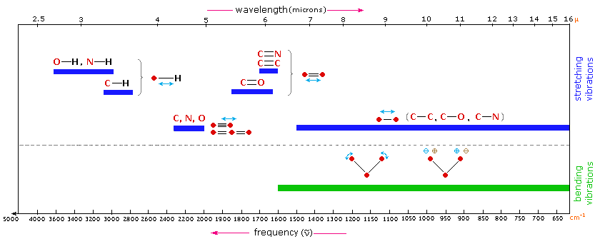
Group Frequency Region
- approximate frequency of many functional groups (C=O,C=C,C-H,O-H) can be calculated from atomic masses & force constants
- positions changes a little with neighboring atoms, but often in same general region
- serves as a good initial guide to compound identity, but not positive proof.

Slide 46
Abbreviated Table of Group Frequencies for Organic Groups
Bond | Type of Compound | Frequency Range, cm⁻¹ | Intensity
C-H | Alkanes | 2850-2970 | Strong
C-H | Alkenes | 3010-3095 675-995 | Medium strong
C-H | Alkynes | 3300 | Strong
C-H | Aromatic rings | 3010-3100 690-900 | Medium strong
0-H | Monomeric alcohols, phenols Hydrogen-bonded alchohols, phenols Monomeric carboxylic acids Hydrogen-bonded carboxylic acids | 3590-3650 3200-3600 3500-3650 2500-2700 | Variable Variable, sometimes broad Medium broad
N-H | Amines, amides | 3300-3500 | medium
C=C | Alkenes | 1610-1680 | Variable
C=C | Aromatic rings | 1500-1600 | Variable
 | Alkynes | 2100-2260 | Variable
C-N | Amines, amides | 1180-1360 | Strong
 | Nitriles | 2210-2280 | Strong
C-O | Alcohols, ethers,carboxylic acids, esters | 1050-1300 | Strong
C=O | Aldehydes, ketones, carboxylic acids, esters | 1690-1760 | Strong
NO₂ | Nitro compounds | 1500-1570 1300-1370 | Strong

Slide 47
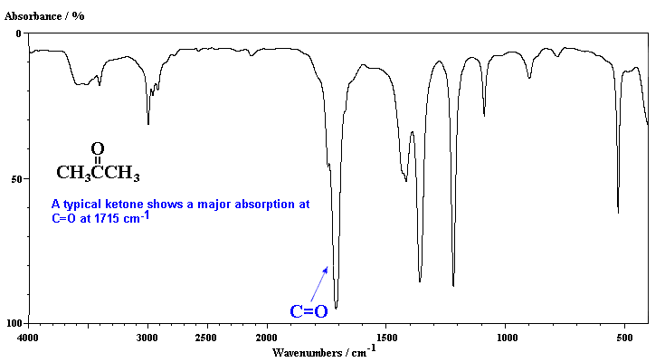
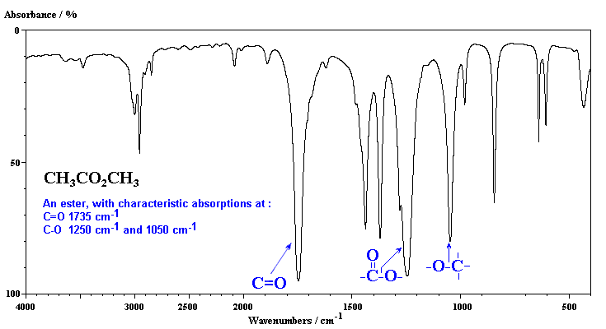
Fingerprint Region (1200-700 cm⁻¹)
Region of most single bond signals
Many have similar frequencies, so affect each other & give pattern characteristics of overall skeletal structure of a compound
Exact interpretation of this region of spectra seldom possible because of complexity
Complexity → uniqueness
Fingerprint Region

Slide 48
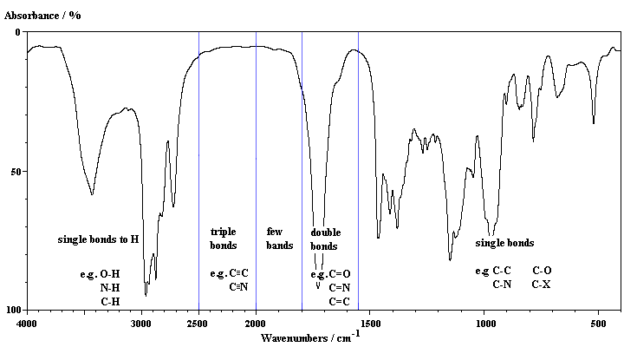

Slide 49
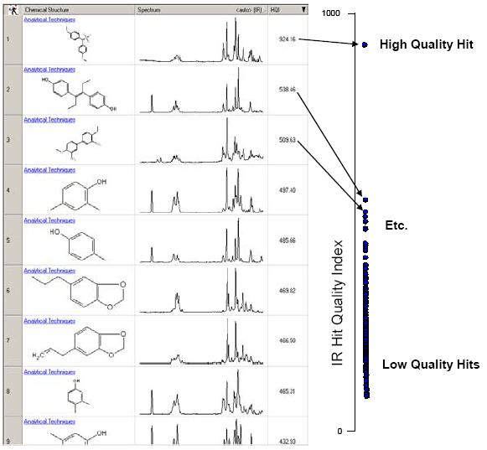
Computer Searches
- many modern instruments have reference IR spectra on file (~100,000 compounds)
- matches based on location of strongest band, then 2nd strongest band, etc overall skeletal structure of a compound
Bio-Rad SearchIT database of ~200,000 IR spectra

Slide 50
Quantitative Analysis
- not as good as UV/Vis in terms of accuracy and precision
► more complex spectra
► narrower bands (Beer’s Law deviation)
► limitations of IR instruments (lower light throughput, weaker detectors)
► high background IR
► difficult to match reference and sample cells
► changes in ε (A=εbc) common
- potential advantage is good selectivity, since so many compounds have different IR spectra
► one common application is determination of air contaminants.
Contaminants | Concn, ppm | Found, ppm | Relative error, %
Carbon Monoxide | 50 | 49.1 | 1.8
Methylethyl ketone | 100 | 98.3 | 1.7
Methyl alcohol | 100 | 99.0 | 1.0
Ethylene oxide | 50 | 49.9 | 0.2
chloroform | 100 | 99.5 | 0.5

Slide 51
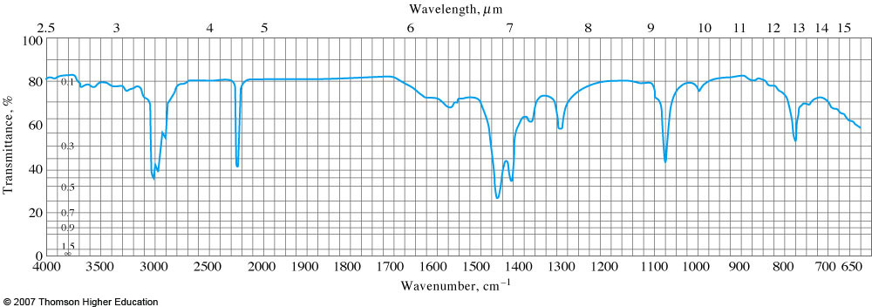
Example : The spectrum is for a substance with an empirical formula of C₃H₅N. What is the compound?
Aliphatic hydrogens
Nitrile or alkyne group
No aromatics
One or more alkane groups

